Slide 1
Sprint 4: Void( )
Down2’s production of hExSCAPE

Slide 2
Sprint Goals and Dates
Team goals for this sprint involved primarily individual tasks. Billy continued his work on our 3D unit models. Gabe worked on creating a connection to the database and creating a constructor that can pull data for a unit from the database. Chris continued to work on the game state controller. Dane worked on building the movement functionality for our units. Michael worked on creating user profiles and the ability to save games. Dane and Michael also collaborated to integrate the main menu and unit spawning code. We aimed to have most of these tasks completed by April 2nd, with the exception of the model work which is ongoing.
We are having our regular stand-up meeting on 3/28/18 as well as our nightly Slack meetings.

Slide 3
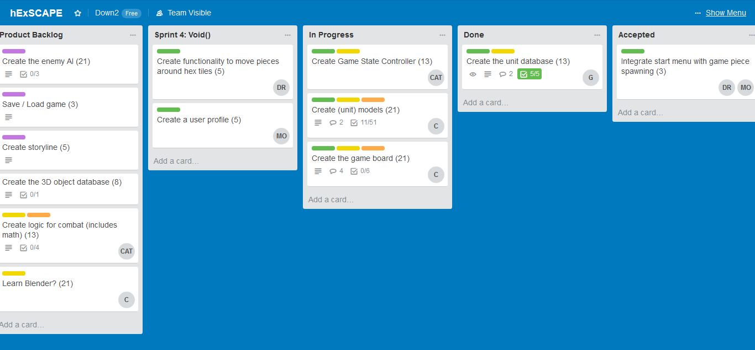
Current snapshot of the Trello board for Sprint 4: Void.

Slide 4
Release Burndown Chart
The team aimed for 60 story points, but only completed 16. Some of this was the result of challenges we faced during the week and some of
it is due to the ongoing nature of some of the related tasks. This burndown was edited as the team refocused on our new objectives, and have a
more realistic estimation of time requirements. That is why the story point total has increased over the sprint 4 plan total.

Slide 5
Chris’ Sprint 4 Goals
Build containers to hold the objects on the hex board into a game state controller.
Generate functions to manipulate the saved data in the game state controller.
Test the game state controller and have it communicate with one of the test hex maps.
I am planning to get 5-10 hours of work done on this Sprint

Slide 6
Chris’ Sprint 4 Accomplishments
Built a “gameStateController” class containing a ton of currently empty objects (hardcoded in some test data)
Basic functions for getting and setting the values of objects stored in the gameStateController are present. They are currently just gets and sets.
Have not gotten things to populate the data from the game state controller into the hexmap scene. Next sprint!
*Completed 5 hours of work toward these goals

Slide 7
Dane’s Sprint 4 Goals
Integrate Michael’s menus with the game scene I created
Enable basic movement around the board
Planning to invest 8 hours toward these goals

Slide 8
Dane’s Sprint 4 Accomplishments
Wrote code to bring appearance of main menu during game play
Failed at importing the chess piece models (likely must download Blender because Unity likes .fbx, .obj, and .mtl files…not .blend)
Failed at moving pieces around the board (several failed attempts allowed me to learn many ways not to do it)
*Completed 6.5 hours of work toward these goals

Slide 9
Billy’s Sprint 4 Goals
Continue building models for the game, including equipment.
Planned time expenditure during Sprint 4: Void will be 10 hours.

Slide 10
Billy’s Sprint 4 Accomplishments
Generated an assortment of models for use in the game.
Created a fancy Unity scene to show off all the new stuff.
Time required was 10 hours.

Slide 11
Michael’s Sprint 4 Goals
Collaborate with Dane to integrate the main menu functionality with the unit spawning functionality.
Create user profiles.
Save configuration data to a file.
I expect to devote about eight hours to these goals during this sprint.

Slide 12
Michael’s Sprint 4 Accomplishments
Completed code to allow the menu to appear over the game board.
Was not able to complete the scripting necessary for user profiles and saving.
I spent about eight hours during this week on these tasks.

Slide 13
Gabe’s Sprint 4 Goals
Create database connection functionality.
Create a constructor for the Unit class that can pull its attributes from the database.
I expect to devote about 10 hours to these goals during this sprint.

Slide 14

Gabe’s Sprint 4 Accomplishments
Created a simple MySQL connection in C# by creating a class, DBConnect.
Used the DB connect class to provide data to the Unit class constructor and instantiate a unit with data from the unit table.
Wrote a short test program that accepts a unit ID from the console and calls the Unit constructor using it.
I spent about ten hours working on this.

Slide 15
Sprint 4: Void( )
This sprint presented our team with significant individual challenges that will required greater collaboration to overcome in the coming weeks.

